Slide 1


ESG meets AI Revolutionizing Sustainability Reporting for KfW Group
KfW@HerHackathon
Team 4
ESG: Environmental, Social and Corporate Governance

Slide 2




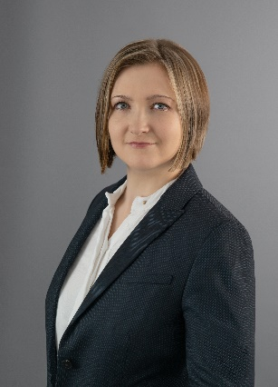

HerHackathon Team4
Bochra Saffar,
Data Scientist
Alena Bauer,
Software Developer
Harshanaa U.S.,
Data Scientist
Anastasia Leutloff,
Project Manager
Neha Thawani,
Technical Consultant

Slide 3





ESG Report Is A Comprehensive Document That Highlights
Social responsibility
Ethical governance
Investment decisions
Building trust
Company's commitment to sustainable practices
ESG: Environmental, Social and Corporate Governance
Notes:
An ESG report is a comprehensive document that highlights a company's commitment to sustainable practices, ethical governance, and social responsibility, playing a crucial role in building trust and attracting investment and influencing banks' reputational risk and investment decisions.
Current Landscape:
Regulatory Frameworks: EU Taxonomy, SFDR, TCFD shaping disclosures.
Standards: GRI, SASB, CDP guide ESG reporting.
Mandatory vs. Voluntary: Increasing regulations, varying by region.
Stakeholder Demands: Rising pressure from investors and consumers for transparency.
Technology: Use of AI, analytics, and blockchain for improved accuracy.
Challenges: Data inconsistency, greenwashing, lack of standardization.
Factors in Bank Rating:
ESG Performance of Companies: Banks assess the environmental, social, and governance practices of companies they invest in or lend to.
Risk Management: Evaluation of how companies manage ESG-related risks.
Transparency: Importance of clear, consistent ESG disclosures from companies.
Reputation: Company ESG ratings influence banks' reputational risk and investment decisions.
Lending Practices: Banks consider the sustainability and responsibility of companies' practices when making lending decisions.

Slide 4

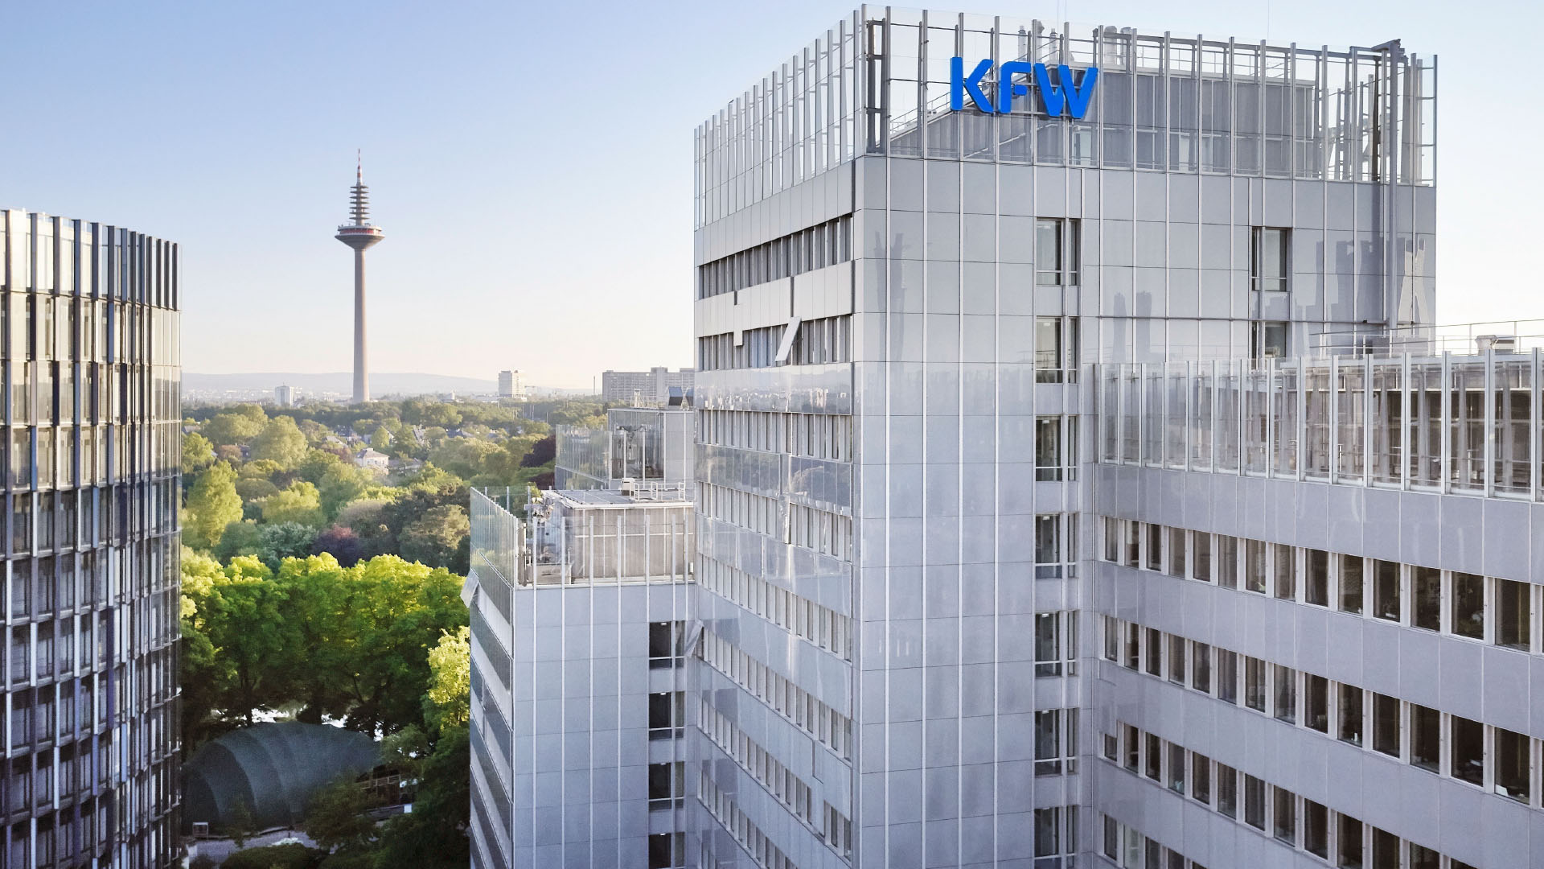


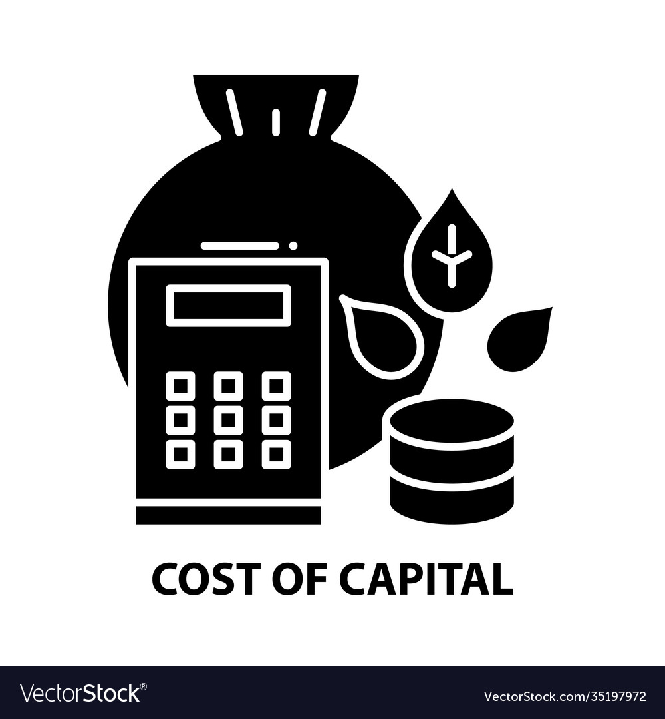
Relevance Of ESG Reports For Companies In The KfW Rating Process
Competitive Advantage
Access to Capital
Risk Management
Cost of Capital
ESG: Environmental, Social and Corporate Governance
Notes:
Bullet Points
Access to Capital: Improves chances of securing loans and investments from banks
Risk Management: Demonstrates effective management of ESG-related risks
Reputation: Enhances corporate reputation and stakeholder trust
Compliance: Ensures adherence to regulatory requirements
Competitive Advantage: Differentiates company in the market, attracting more investors and customers
Transparency: Provides clear and consistent information about ESG practices
Sustainability: Shows commitment to sustainable practices, appealing to socially conscious investors
Cost of Capital: Potentially lowers cost of capital due to reduced risk perception

Slide 5

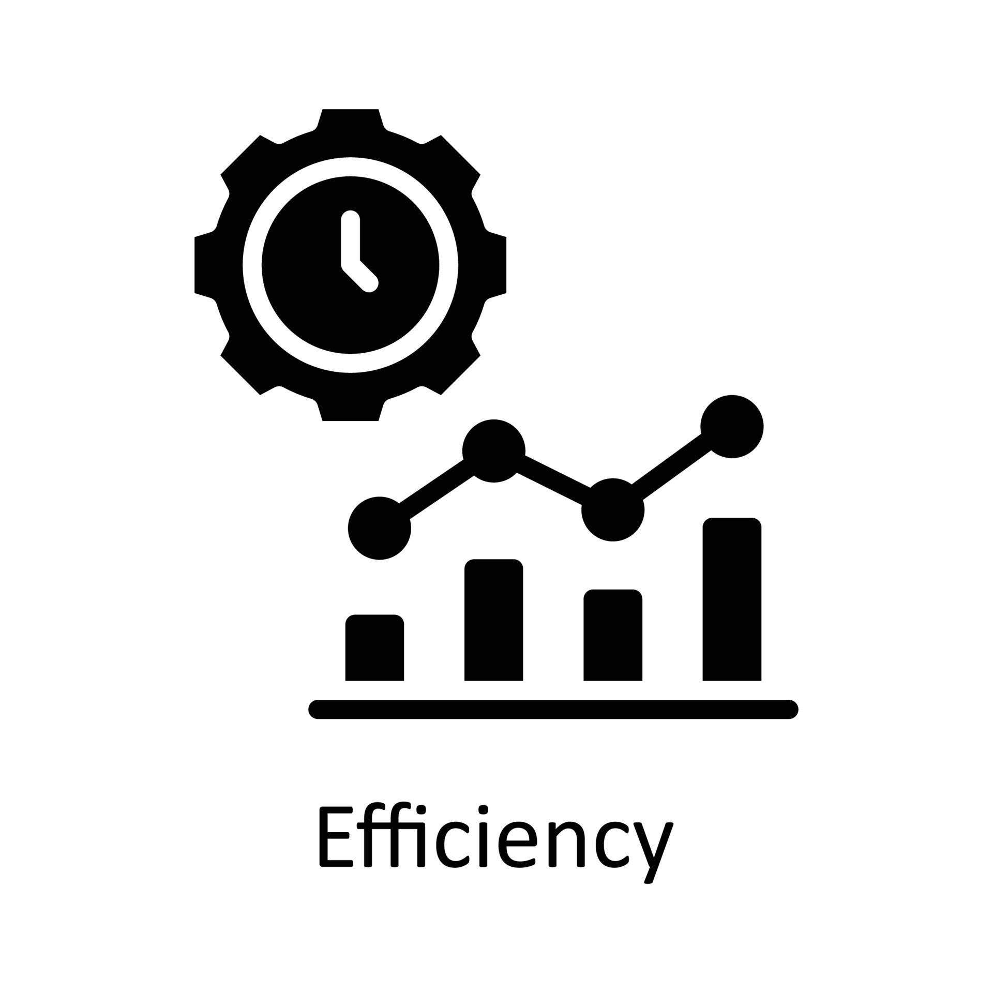



Verena’s Needs In The Current Situation
Efficiency
Structure and transparency
Accuracy
Regulatory Compliance
ESG: Environmental, Social and Corporate Governance
Notes:
Ausgangssituation Title: Erfassung von ESG-relevanten Eigenschaften von Kreditnehmern (Capturing ESG-Relevant Characteristics of Borrowers).
Description: Verena, a rating analyst at KfW, needs to update ratings at least once a year, or more frequently if risk events occur. ESG risks are relevant for the bank's control and how external factors affect Verena's portfolio and KfW.
Key Points:Collection of all ESG-relevant characteristics of a borrower during the rating process.
Structured questionnaire for sustainability reports.
Documentation must be regulatory relevant, verifiable, and systematic.
The collection should be time-efficient, content accurate, and require minimal manual effort.
Title: Verena, Rating Analyst at KfW
Task: Annual rating updates, more frequent for risk-relevant events
Focus: ESG risks' impact on her portfolio and KfW's portfolio (Outside-In Perspective)
Example:
Outside-In Perspective: Verena uses GenAI to understand how external environmental regulations, social changes, and governance issues affect the creditworthiness of companies in her portfolio.
Impact Analysis: Assesses how a new environmental law impacts the credit ratings of industrial firms, informing timely adjustments to risk management strategies.
Real-World Impact: Enables proactive adjustments to KfW's investment strategies based on real-time ESG risk data.

Slide 6

Introducing GenAI Magic For ESG Reporting
Read PDF
Convert PDF to text
Split text into sections
Identify relevant sections
Generate answers from the text
Evaluate results in customer-friendly user interface
ESG: Environmental, Social and Corporate Governance
Notes:
Summary
Current State: KfW has a team of 20 FTEs dedicated to ESG report analysis.
Manual Analysis Time: 8 hours per report.
Automated Analysis Time with GenAI: 5 hours per report.
Total Reports Analyzed Annually: 1000 reports.
Total Time Savings: 3000 hours annually.
FTE Savings: Approximately 3 Full-Time Equivalents (FTEs) annually.
Cost Savings: €240,000 annually.
This table format clearly shows the detailed business case, highlighting the time and cost savings KfW can achieve by using GenAI for ESG report analysis.

Slide 7
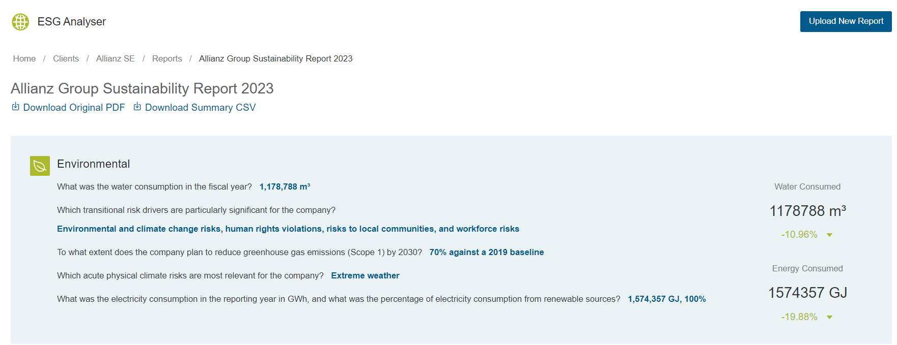
Our Business Solution For The KfW Needs
https://esg-analyser.azurewebsites.net/
Notes:
Problemstatement

Slide 8


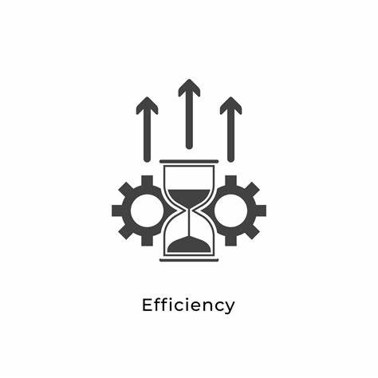
Empowering KfW's Sustainability Mission
Labor Cost Savings 200k€
Time Savings 50%
Operational Efficiency 30% ↑
Employee Productivity 20%↑
ESG: Environmental, Social and Corporate Governance
Notes:
Multilingual Support: Extend the solution to support multiple languages for global applicability.
Real-time Updates: Incorporate real-time data sources to keep the analysis up-to-date.Advanced Analytics: Add more advanced analytics capabilities, such as trend analysis and predictive insights.
Slide 7: Key Benefits for KfW (1 minute)
Title: Empowering KfW's Sustainability Mission
Visuals: KfW’s mission statement and GenAI interface mockup
Text:
Enhanced Decision-Making: Informed strategies and investments
Stakeholder Engagement: Transparent reporting
Efficiency Gains: Saves time and effort
Business Case:
Current State: KfW has a team of 20 FTEs dedicated to ESG report analysis.
FTE Savings: By automating the analysis of ESG reports, KfW can save approximately 3 Full-Time Equivalents (FTEs) annually.
Time Savings: Manual analysis of ESG reports can take up to 50 hours per report. With GenAI, this time is reduced to 5 hours, resulting in a time savings of 90%.
Cost Savings: Assuming an average cost of €80,000 per FTE, the annual savings in labor costs would be approximately €240,000.
Business Case:
Current State: KfW has a team of 20 FTEs dedicated to ESG report analysis.
Manual Analysis Time: It takes about 8 hours to manually analyze each ESG report.
Reports per FTE: Each FTE analyzes 32 reports per year to match the 3 FTE savings.
Total Reports Analyzed Annually: 20 FTEs * 32 reports/FTE = 640 reports per year.
Time Savings: Manual analysis of 640 ESG reports takes 5120 hours. With GenAI, this time is reduced to 3200 hours, resulting in a time savings of 1920 hours annually.
FTE Savings: By automating the analysis of ESG reports, KfW can save approximately 3 Full-Time Equivalents (FTEs) annually.
Cost Savings: Assuming an average cost of €80,000 per FTE, the annual savings in labor costs would be approximately €240,000.
Efficiency: Automates the analysis of sustainability reports, saving time and resources (~240k€)
Accuracy: Provides precise and reliable answers to complex ESG-related questions.
Compliance: Helps organizations stay compliant with regulatory requirements.
Scalability: Scalable solution that can handle a large volume of reports and queries.

Slide 9





Understanding the Risks and Biases
Risk/Bias | Rating | Mitigation Strategy
 |  | Implement robust data protection protocols
 |  | Ensure thorough data validation and cleaning
 |  | Regularly audit and update AI models
 |  | Provide clear explanations and training for users
 |  | Maintain a balance between AI use and human oversight
ESG: Environmental, Social and Corporate Governance
Notes:
Privacy Concerns
Data Quality
Algorithmic Bias in the AI model
Misinterpretation of AI-generated insights
Dependence on AI

Slide 10
Thank You For Your Attention And Let’s Shape A Sustainable Future!

Slide 11
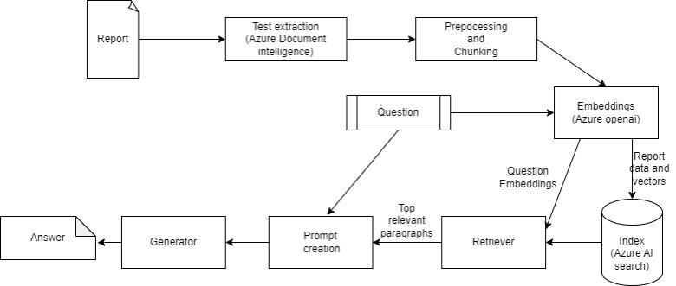
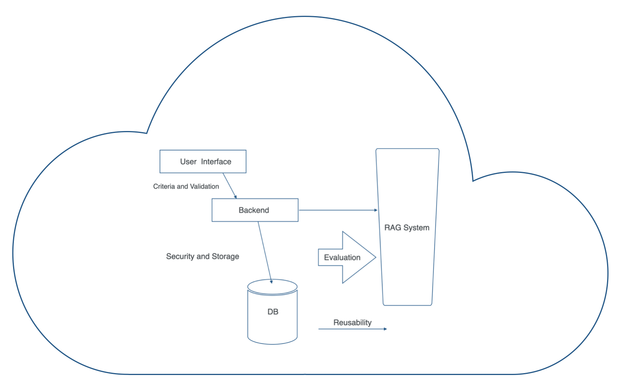
Our Business Solution For The KfW Needs
Notes:
Problemstatement

Slide 12
Overview of ESG-Relevant Characteristics
Characteristic | Description
Sustainability Reporting | Is there sustainability reporting in the company? If yes, state the standard used by the company.
Water Consumption | What was the water consumption in the fiscal year?
Transitional Risk Drivers | Which transitional risk drivers are of particular importance to the company?
GHG Emissions Reduction Plan | To what extent does the company plan to reduce greenhouse gas emissions (Scope 1) by 2030?
Acute Physical Climate Risks | What acute physical climate risks are most relevant to the company?
Gender Diversity Goals | What goals does the company pursue to increase the proportion of women in leadership positions?
Women in Leadership | What is the percentage of women in leadership positions in the reporting year?
Sustainability Officer | Is there a person responsible for sustainability in the company? If yes, are they a member of the board?
Incentives for Sustainability Goals | Is the achievement of sustainability goals part of the board's remuneration system?
Electricity Consumption | What was the electricity consumption in the reporting year in GWh and what percentage was from renewable energy sources?
Notes:
Problemstatement

Slide 13
Business Case
Parameter | Value | Calculation/Notes
Manual Analysis Time | 8 hours/report | Time taken to manually analyse each ESG report
Automated Analysis Time | 4 hours/report | Time taken to analyze each ESG report with GenAI
Reports per FTE | 50 reports/year | Number of reports analysed by each FTE annually
Total FTEs | 20 FTEs | Number of FTEs dedicated to ESG report analysis
Total Reports Analyzed Annually | 1000 reports | 20 FTEs * 50 reports/FTE
Current Effort (Manual) | 8000 hours | 1000 reports * 8 hours/report
Effort with GenAI | 4000 hours | 1000 reports * 4 hours/report
Total Time Savings | 4000 hours | 8000 hours (manual) - 4000 hours (automated)
Standard Annual Working Hours per FTE | 1600 hours | Assuming 40 hours/week * 40 weeks/year
FTEs Saved | 2,5 FTEs | 4000 hours saved / 1600 hours per FTE
Average Cost per FTE | € 80.00 | Including salary, benefits, and overhead
Annual Labor Cost Savings | € 200.000 | 2,5 FTEs * €80.000/FTE
Notes:
Problemstatement

Slide 14
Enhanced Key Benefits for KfW
Benefit | Value | Explanation
FTE Savings | 2.5 Full-Time Equivalents (FTEs) | By automating the analysis of ESG reports
Time Savings | 4000 hours annually | Significant reduction in time spent analysing reports
Cost Savings | €200.000 annually | Based on the average cost per FTE (€80,000)
Accuracy | Provides precise and reliable answers to complex ESG-related questions | Enhanced data processing accuracy, consistent results
Compliance | Helps organizations stay compliant with regulatory requirements | Up-to-date with ESG regulations and standards
Scalability | Scalable solution that can handle a large volume of reports and queries | Capable of processing thousands of reports without degradation in performance
Report Turnaround Time | Reduced by 50% | From 8 hours to 4 hours per report
Enhanced Decision-Making | Improved strategic decisions | Informed by accurate and timely ESG insights
Stakeholder Engagement | Increased transparency | Clear and comprehensive ESG reporting
Employee Productivity | 20% increase | By reducing manual workload, employees can focus on higher-value tasks
Operational Efficiency | 30% improvement | Streamlined processes and reduced bottlenecks
Notes:
Problemstatement

Slide 15
Evaluation criteria
Criteria | Value
context_precision | 0.720914
faithfulness | 0.757119
Answer similarity | 0.892362

Slide 16
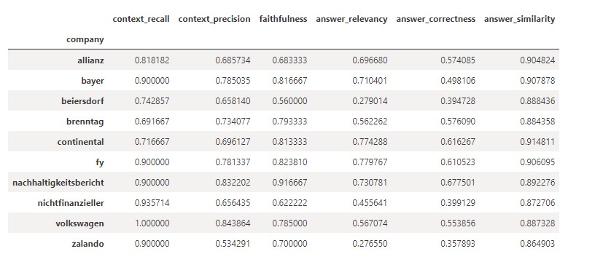
Evaluation criteria

